Slide 1
MLP Neural Networks for Digit Recognition
erghm,
Abelardo Riojas
ISC 4932 Fall 2021 Prof. Plewa
The “Hello World” of Machine Learning

Slide 2
Paper cited
Saeed AL-Mansoori Int. Journal of Engineering Research and Applications www.ijera.com ISSN : 2248-9622, Vol. 5, Issue 5, ( Part -3) May 2015, pp.46-51

Slide 3
INTRODUCTION
Here are some examples of a handwritten “4”. Your brain has no trouble distinguishing each one as a four, although the actual pixel positions of each one are very different.
The particular light sensitive cells in your eyes that are firing tell you that it’s a four, effortlessly.
The goal of this algorithm is to take in handwritten digits rendered at say, 28x28 pixels, and spit out the correct digit (0 - 9), by giving it labeled data to “train” and “learn” on, and we evaluate our performance on labeled “testing” data to evaluate our performance.
What seems like a surprisingly easy task for us, suddenly became dauntingly difficult!

Slide 4

INTRODUCING THE NEURAL NETWORK!

Slide 5
What are the neurons?
Think of them as things that hold a number between 0 and 1.
Our input layer of neurons would have 784 (28 * 28) neurons, each representing how “activated” a pixel is.
1 being white, 0 being black.
Our last layer, the output layer, has 10 neurons, corresponding to each digit (0-9).
If we feed an example of a four to our NN, the fifth neuron should be the most activated. Meaning we’ve successfully classified it.
The layers in between are the hidden layers, we’ll discuss those in a bit. For now, think of them as a black box.

Slide 6
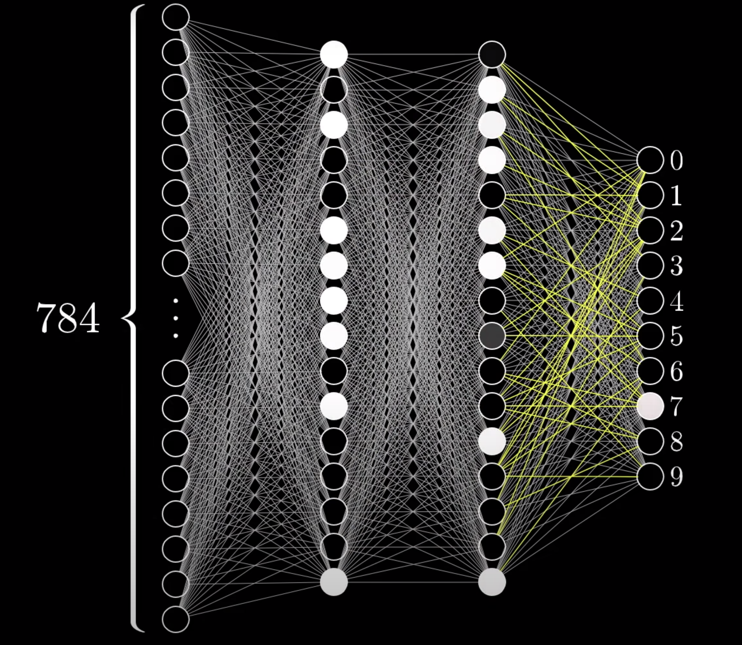
Forward Propagation Intro
NN use the principle that activations in one layer influence the activations in another layer.
This comes from biology, where if one neuron is firing, it causes other neurons to fire as well.
If we give the NN a seven, the activations in the input layer cause the second layer to fire in a certain way. That layer activates the third layer, which activates the output layer.

Slide 7
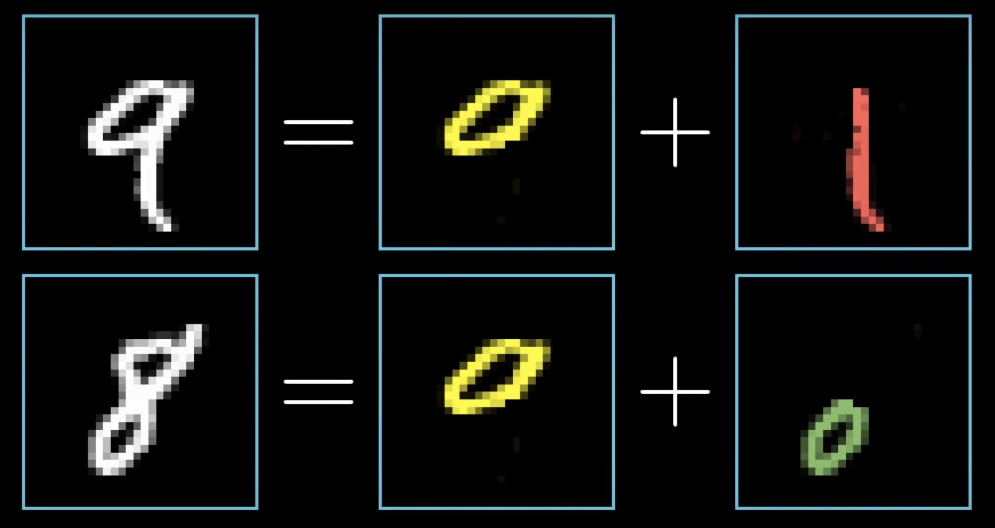
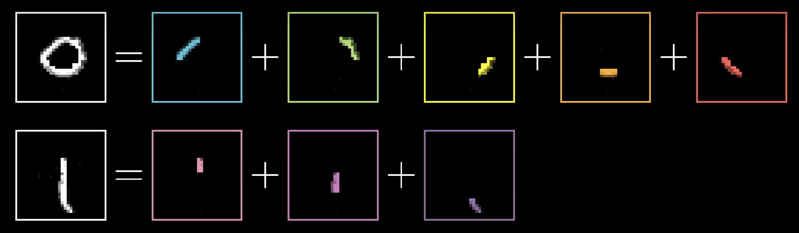
Why Layers?
Larger components of the number are split up into recognizable edges, which are made up of even smaller edges.

Slide 8
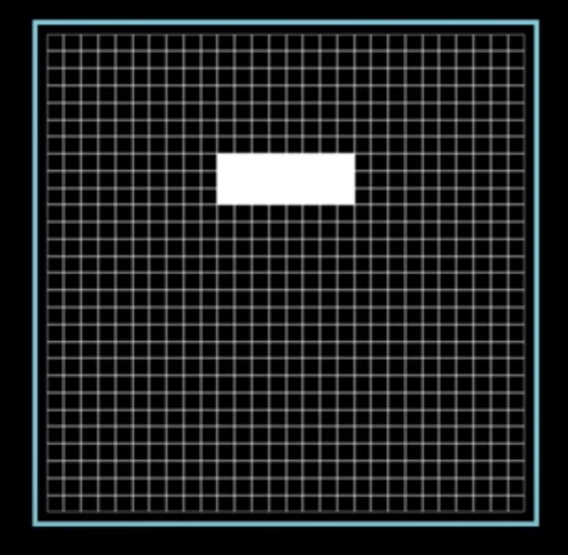
Edge Detection
We’re trying to detect an edge in this region of the image.
How do we get the second layer to activate when this combination of pixels is lit up?
We assign weights to each neuron and compute the weighted sum.

Slide 9
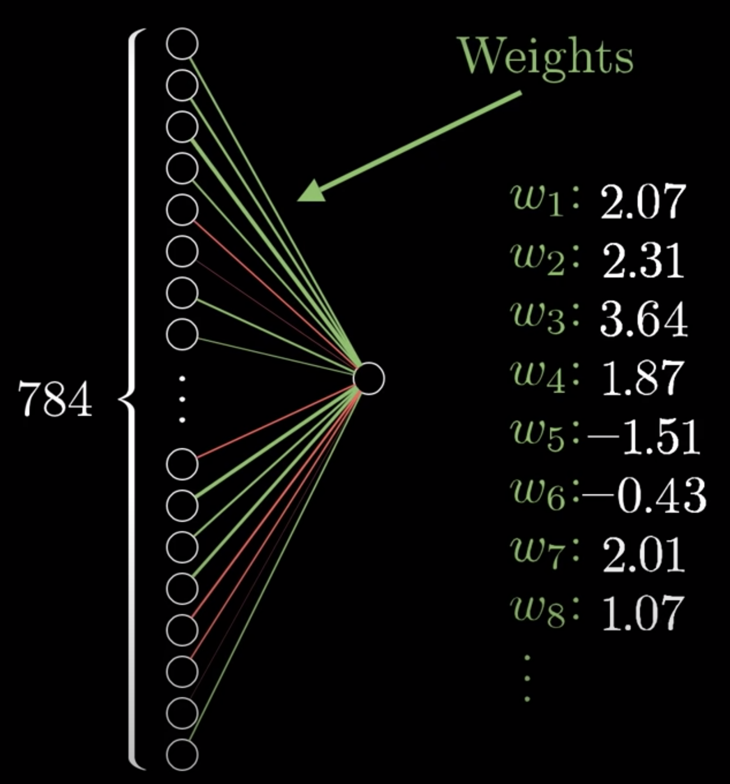
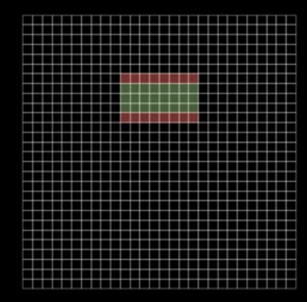
Weights explained
Green = positive weight, red = negative weight, black = 0 weight.
Here, the sum is largest when the green values are lit, and the red values are not. All others we do not care about.

Slide 10
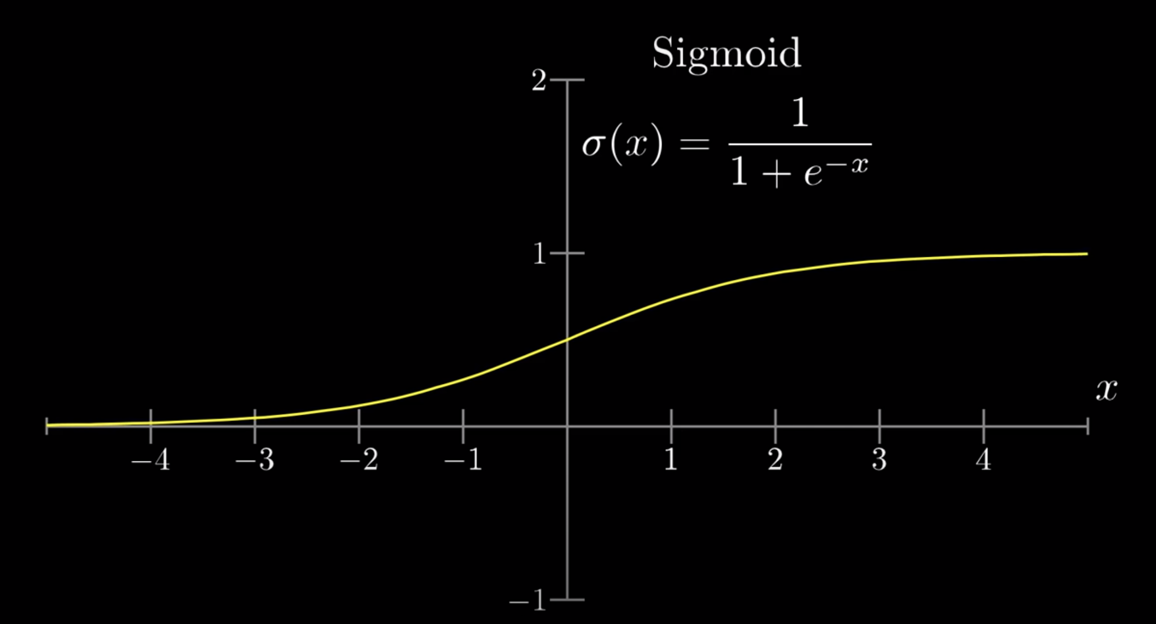
The Sigmoid Function
When we compute our weighted sum, we can get numbers that vary in range.
We want our neurons to stick to values of 0 and 1.
Introducing the sigmoid function!

Slide 11
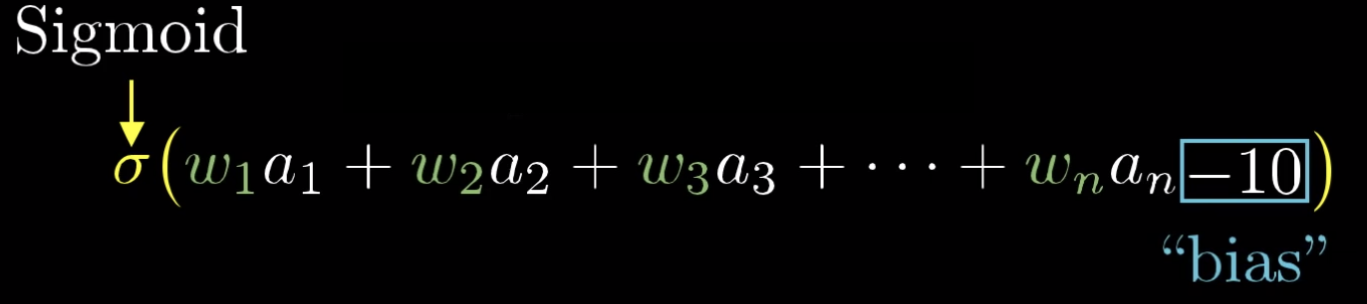
Bias
Usually in a NN, we only want our neurons to light up when there is some “meaningful” activation. Right now our neuron will fire simply if the value of the weighted sum is bigger than 0.
We can work around that by adding bias into the system.
If we subtract, say -10 from the sum, it will only activate when the sum has a value larger than 10.
Think of the bias as an extra neuron with a variable value but fixed weight of 1.

Slide 12
Zooming out for a second
The knobs and dials of our algorithm are the weights and biases of the NN. Tweaking these values based on the training data is how the machine “learns”
In our 784-16-16-10 example, each of the 784 neurons has 16 weights to each neuron in the second layer, and that second layer has 16 weights for each neuron in the third, and the third layer has 10 weights for the 10 output neurons.
Along with this there are also biases for each neuron in the second, third, and last layer.
Combined that’s (784*16) + (16*16)+ (16*10) + (16 + 16 + 10) = 13002 different parameters! 😳
Weights Biases

Slide 13
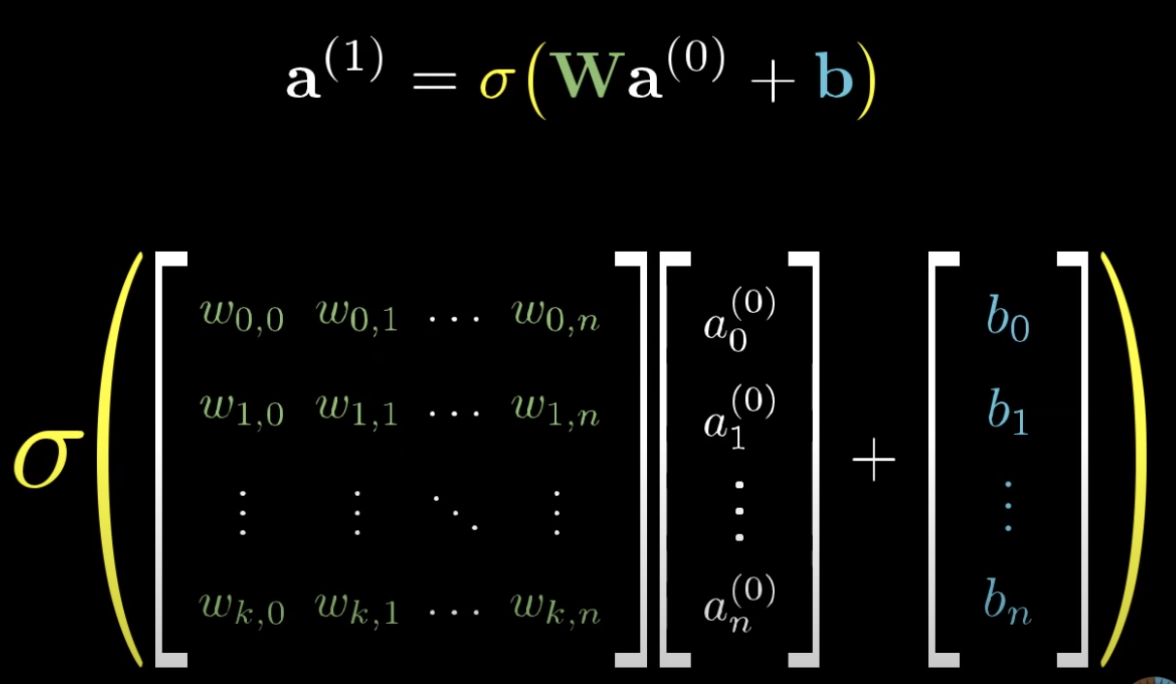
Linear Algebra to make life easier
Now we can think of neurons as functions that take in parameters, apply weights and biases, squashes it with the sigmoid, and spits out an activation!
Here we put the activations of the previous layer into a vector, put the weights into a matrix, multiply, add the biases, and push every number in the resulting vector into the sigmoid to get our next layer’s activation.

Slide 14
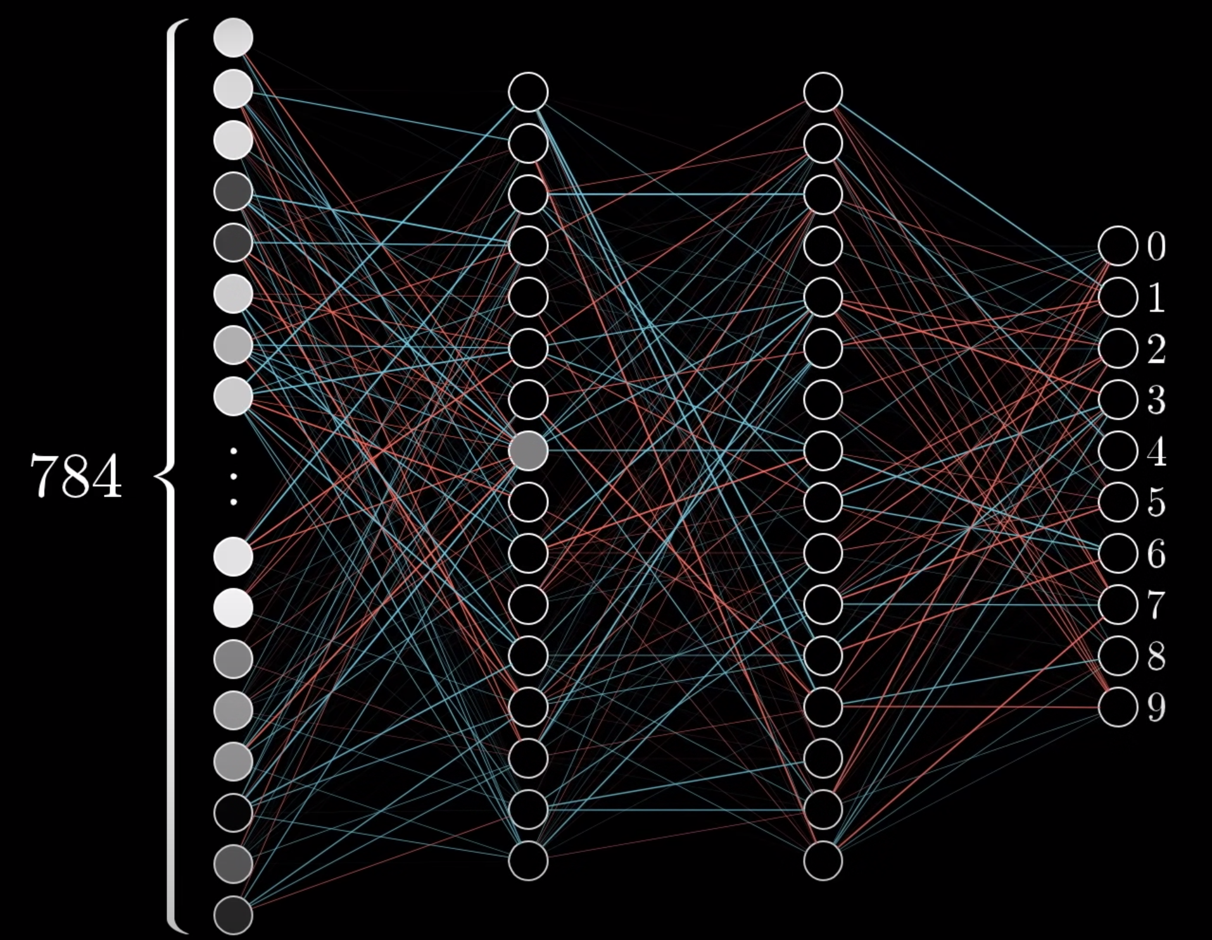
Backpropagation Intro
Start off by completely randomizing all of the weights and biases.
Obviously this will perform pretty terribly on the training data.

Slide 15
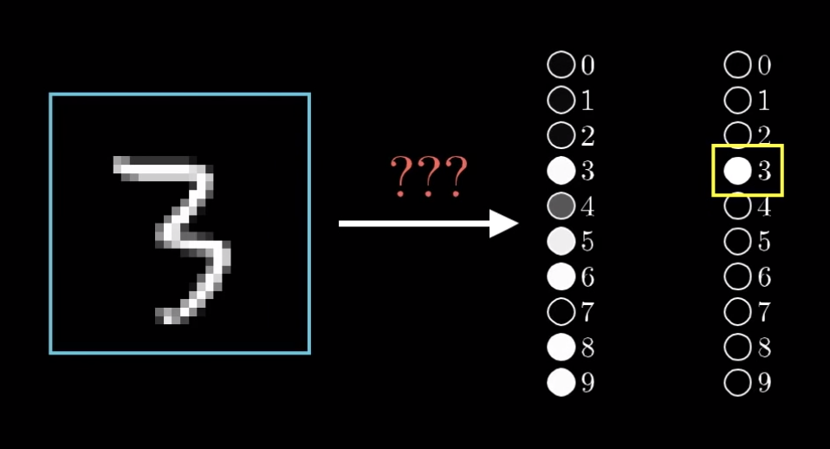
The cost function, C(x)
Let’s say we feed the NN with a 3, and it spits out what looks like utter garbage.
Our cost function takes in the output given by the NN, and subtracts that vector from our desired output and takes the square of each number in the vector.
The sum of that vector is the “cost” of our training example.

Slide 16
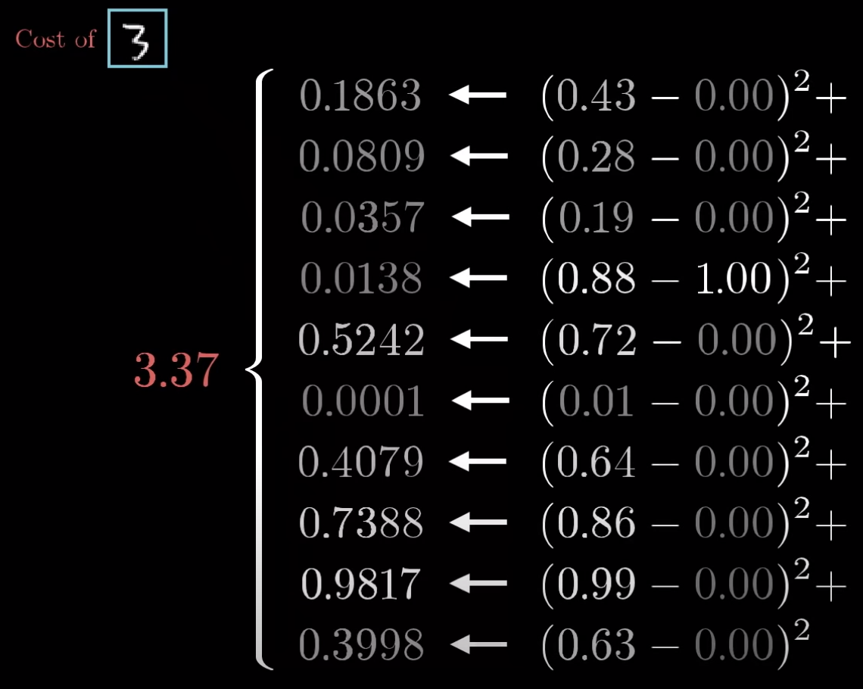
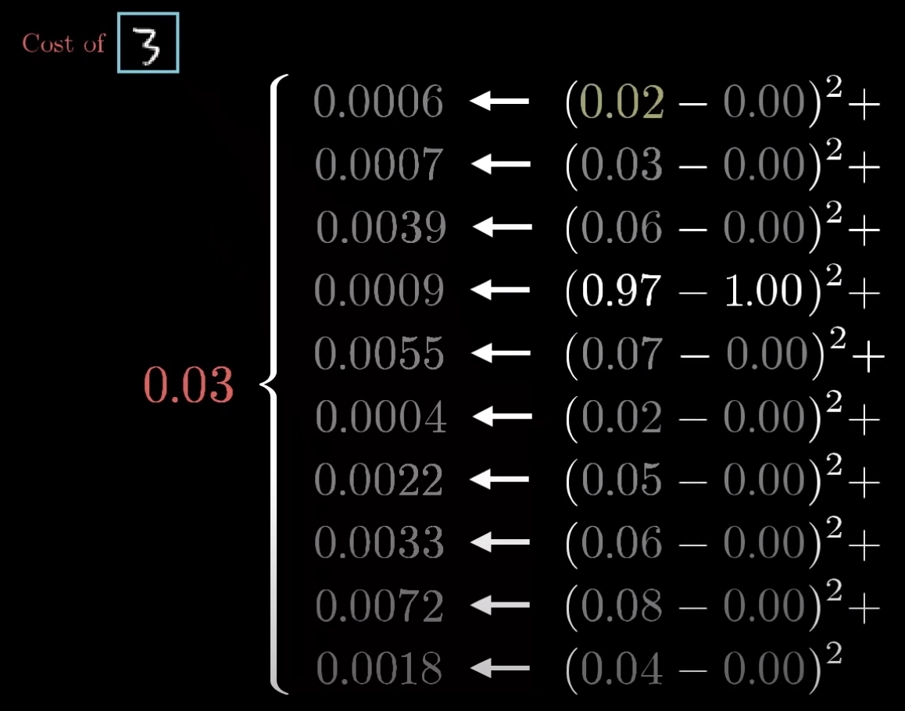
The cost function, C(x)
Notice how the C(x) is large when we have a dumpster fire, and small when we have what we want.

Slide 17
The cost function, C(x)
Now let’s consider taking the average cost of the NN over all of our training examples. More mathematically that’s the Mean Squared Error (MSE) of our training examples.
That MSE is our measure for how well the NN is classifying our outputs.
But just telling the computer that it’s doing a bad job doesn’t do much, how do we get the computer to change for the better?
The key here is that we want to minimize the cost function.
Let’s remember:
The network acts like a function with 784 inputs, 10 outputs, and 13002 parameters.
The cost function is a function with 13002 inputs, 1 output, and the parameters are the thousands of training data we have.

Slide 18
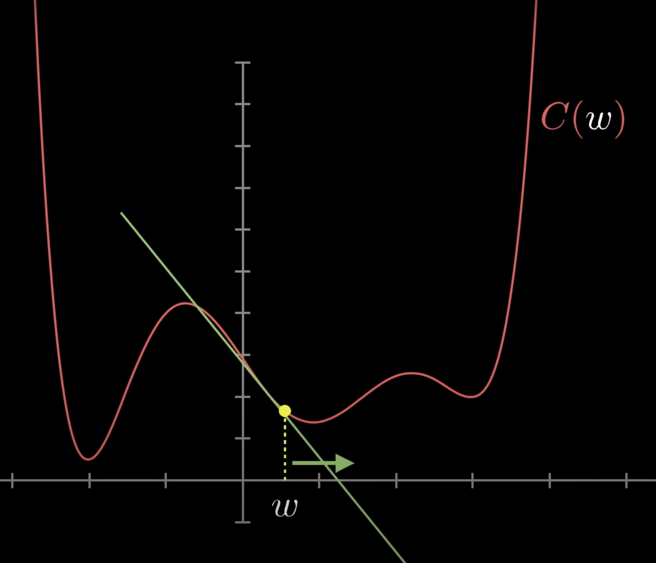
How do we minimize C(x)?
Let’s use calculus!
Consider a function with just one input instead of 13002. It would be easy to find an expression for the minimum of that function analytically.
Setting the derivative equal to 0, finding critical points, etc.
But that can be hard for complicated functions, especially ours, with all these different parameters.
Instead, we should be using gradient descent. Finding the derivative, and taking a small step to the left if it’s positive, and a small step to the right if it’s negative, in order to approach some local minimum of the function.

Slide 19
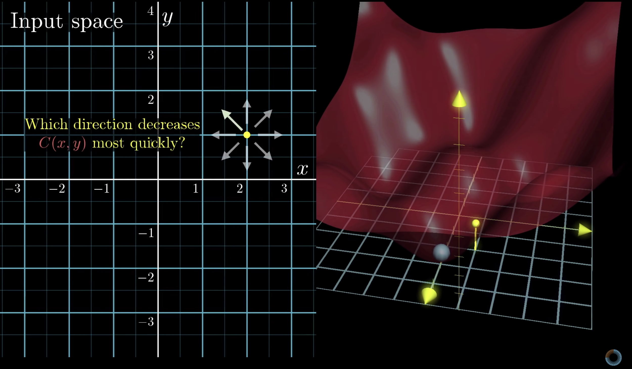
Gradient Descent Explained
Imagine instead a function with two inputs and one output.
You might think of the input space as the XY plane and the cost function as being graphed as a surface above it.
Now instead of asking about the slope of the function you have to ask which direction should you step in this input space, to find the minimum of the function.
Those of you familiar with multivariable calculus will know that the gradient of a function gives you the direction of steepest ascent.
Naturally enough taking the negative of that gradient gives you the direction to step that decreases the function most quickly
Even more, the length of this gradient vector is actually an indication for just how steep that steepest slope is.

Slide 20
Backpropagation steps
Now that we understand gradient descent, we have an understanding as to how the machine actually learns.
Step one: For each training example, compute the negative gradient vector -∇C
Step two: Take a small step in that direction
Step three: repeat until you’re at a minimum.
There are a lot more intricacies to explain here, but that’s the general idea!
We will now focus on how to actually compute that vector.

Slide 21
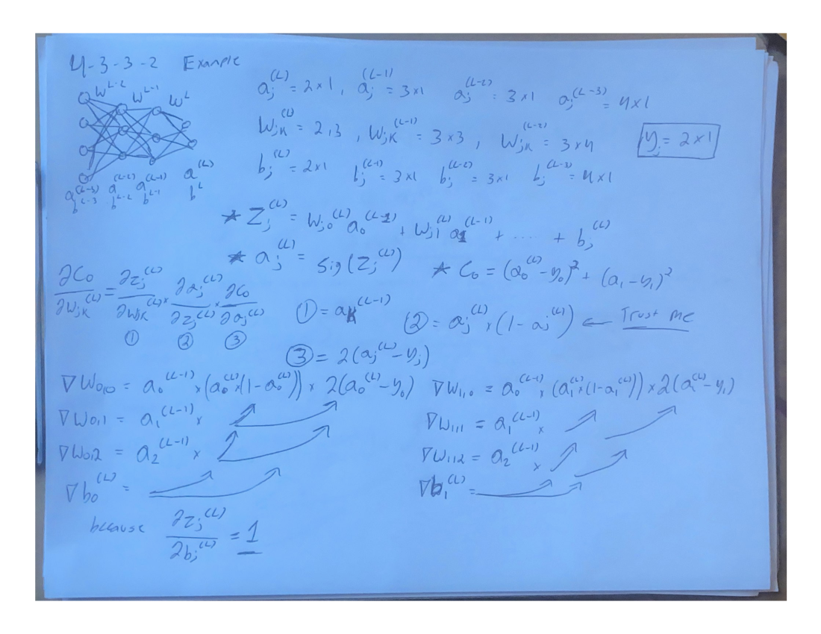

Slide 22
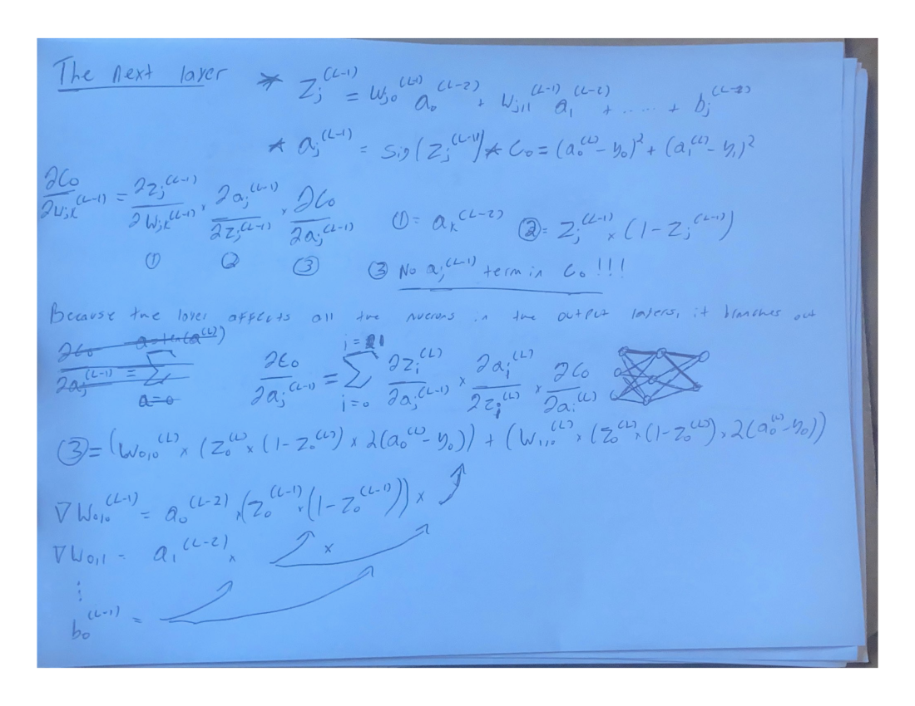

Slide 23
ANY QUESTIONS????
Thank you for listening! 🥰

